Slide 1
Feature Model Merging Algorithms
Li Yi
from Domain and Requirements Engineering Research Group, SEI, PKU
2010.12.30

Slide 2
Agenda
Preliminaries: Feature Models
Motivation: Why merge FMs?
Approaches
Simple Combination Approach
Rule-based Approach
Logical Formula Approach
Our Work

Slide 3
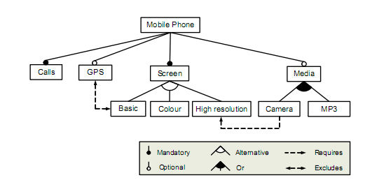
Preliminaries: Feature Models
(Domain) feature models provide a way to describe commonality and variability of the products in a specific domain.
from Feature Oriented Domain Analysis (FODA) Feasibility Study,
CMU/SEI-90-TR-21, 1990
Notes:
What is feature model?

Slide 4
Preliminaries: Feature Models
A product is created through a selection or configuration of features.
Mobile Phone #1: { Calls, GPS, Color Screen, MP3 }
Mobile Phone #2: { Calls, High Resolution Screen, Camera, MP3 }
…
Notes:
What is feature model?7

Slide 5
Agenda
Preliminaries: Feature Models
Motivation: Why merge FMs?
Approaches
Simple Combination Approach
Rule-based Approach
Logical Formula Approach
Our Work

Slide 6
Why merge feature models?
Reuse feature models
In software supply chains, a company buys a set of components (expressed in feature models) from several suppliers
Then the company merges them into a new product line
Its own software (features, or feature models) may be combined into the product line as well.
For each of its customers, a specialized product may be created from the product line.

Slide 7
Why merge feature models?
Feature model evolution
In software product lines, a feature engineer’s duty is to add new interesting features to the product line.
If two feature engineers work in parallel, we want to put the two extended product lines together after a period of time.
We also want to ensure that existed products of the two extended product lines can be preserved in the merged product line, therefore the business will not be affected.

Slide 8
Why merge feature models?
Managing multiple feature models
In software supply chains, a company buys a set of components (expressed in feature models) from several suppliers
Then the company merges them into a new product line
Its own software (features, or feature models) may be combined into the product line as well.
For each of its customers, a specialized product may be created from the product line.
Supplier 1
Supplier 2
Supplier 3
Upstream
Downstream

Slide 9
Agenda
Preliminaries: Feature Models
Motivation: Why merge FMs?
Approaches
Simple Combination Approach
Rule-based Approach
Logical Formula Approach
Our Work

Slide 10
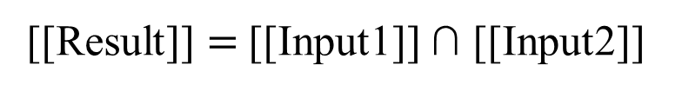
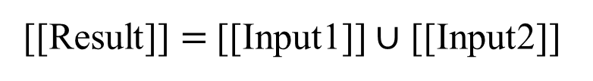
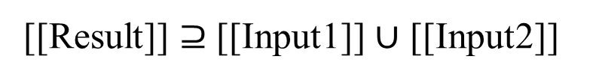
Definition of merge operation
The merge operation is defined through the product set of input and result feature models.
In the slides, we use the symbol [[ Feature Model ]] to denote the product set of the feature model.
merge (Union mode)
merge (Strict union mode)
merge (Intersection mode)
Three Kinds of Merge Operation
[[Result]] $⊇$ [[Input1]] ∪ [[Input2]]
[[Result]] $=$[[Input1]] ∪ [[Input2]]
[[Result]] $=$[[Input1]] ∩ [[Input2]]
Notes:
There’re two modes of merge operation: Union and Intersection.
By merging two input feature models, we want to preserve the semantics of the variability. The semantics is defined by the valid product set of feature models.

Slide 11
Agenda
Preliminaries: Feature Models
Motivation: Why merge FMs?
Approaches
Simple Combination Approach
Rule-based Approach
Logical Formula Approach
Our Work

Slide 12
Simple Combination Approaches
Basic idea
Connect the input FMs with additional features and relations to get the result.
The input FMs will appear as a part of result FM.
Notes:
简单拼接法
[Supplier independent feature modeling, 2009]
用了比较另类的merge方法，类似最简单的组合
[Generic semantics of feature diagrams, 2006]
最简单的实现方式

Slide 13
Approach #1
Generic semantics of feature diagrams. 2006
Strict union mode: [[Result]] = [[FM1]] ∪ [[FM2]]
Join the input FMs with a XOR relation.
Example
R
A
A
A
A
A
B
C
B
C
B
C
B
C
B
C
FM1
FM2
Expected
Result
PRODUCTS
{A, B}
{A, C}
{A, B}
{A, B, C}
{A, B}
{A, C}
{A, B, C}
{A, B}, {A, C}
{A, B}, {A, B, C}
Notes:
Union: Join input FMs by a XOR relation.
Intersection: Join input FMs by AND relation.

Slide 14
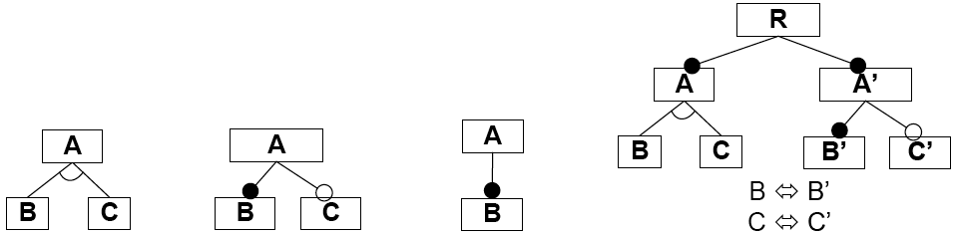
Approach #1 (Cont.)
Intersection mode: [[Result]] = [[FM1]] ∩ [[FM2]]
Rename the same features in inputs.
Join the input FMs with an AND-Mandatory relation.
Add mutual-requires relations between the same leaf-features.
Example
FM1
FM2
Expected
Result
PRODUCTS
{A, B}
{A, C}
{A, B}
{A, B, C}
{A, B}
{A, B, A’, B’, R} –
{R, A’, B’} = {A, B}

Slide 15
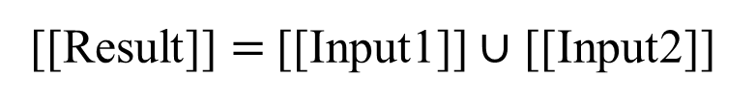
Approach #2: Overview
Supplier independent feature modeling . 2009
An approach from the industry (NXP Semiconductors, The Netherlands)
A strict union mode merging
The problem to address
FM Selection: Choose an FM from a set of FMs provided by various suppliers
Most features in the supplied FMs are connected with some artifact (e.g. code), therefore the selection above have to keep such connection as untouched as possible
[[Result]] $=$[[Input1]] ∪ [[Input2]]

Slide 16
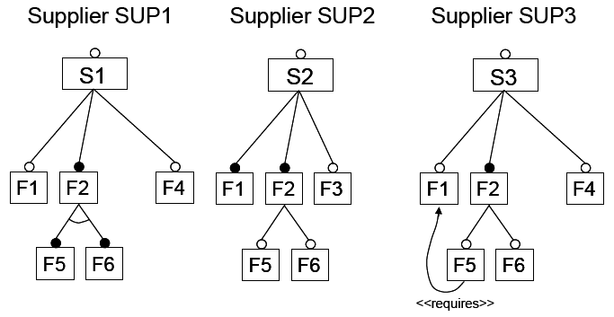
The Proposed Approach
Step 1: Identify the correspondence between features from different suppliers.
Notes:
Step 2: Create a sub-tree to describe the supplier
variability.
Step 3: Create a complete list of the corresponding
features, which will become the leaves of the Supplier
Independent Feature Model.
Step 4: To create a tree-like structure, use the
structure which is common in the referenced SSFMs,
e.g. parent child relations and grouped features.
Step 5: Add the dependency relations between the
corresponding features in the SIFM and the SSFMs
and the relations between the suppliers and their
SSFMs. This combination forms the CSFM.

Slide 17

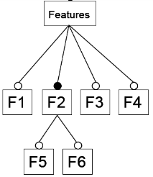
The Proposed Approach
Step 2: Create an FM called Supplier Independent Feature Model (SIFM) contains all features from all the suppliers.
HOW TO
If a feature F exists in several FMs, and in all these FMs, F has the same parent P ➔ Add the parent and child to SIFM.
Otherwise, add F as the child of the root of SIFM.
Only mandatory and optional relations exist in SIFM, where
If F is mandatory in all FMs ➔ F is mandatory.
Otherwise F is optional.
Notes:
Step 2: Create a sub-tree to describe the supplier
variability.
Step 3: Create a complete list of the corresponding
features, which will become the leaves of the Supplier
Independent Feature Model.
Step 4: To create a tree-like structure, use the
structure which is common in the referenced SSFMs,
e.g. parent child relations and grouped features.
Step 5: Add the dependency relations between the
corresponding features in the SIFM and the SSFMs
and the relations between the suppliers and their
SSFMs. This combination forms the CSFM.

Slide 18
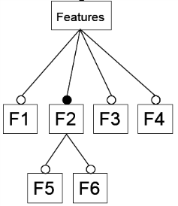
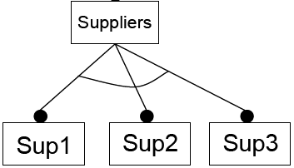
The Proposed Approach
Step 3: Create a sub-tree standing for the suppliers. Put all trees together.
Suppliers
SIFM
Inputs

Slide 19
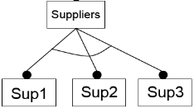
The Proposed Approach
Step 4: Add dependencies between Suppliers and Inputs, SIFM and Inputs.
HOW TO
Choose one from inputs: SIFM.F requires XOR({Input.F | Input ∈ Inputs})
Trace from inputs to SIFM: Input.F requires SIFM.F
Who supplies what: Sup1 requires S1, S1 requires Sup1, Sup2 requires S2, S2 requires Sup2, …
Suppliers
SIFM
Inputs
Notes:
Step 2: Create a sub-tree to describe the supplier
variability.
Step 3: Create a complete list of the corresponding
features, which will become the leaves of the Supplier
Independent Feature Model.
Step 4: To create a tree-like structure, use the
structure which is common in the referenced SSFMs,
e.g. parent child relations and grouped features.
Step 5: Add the dependency relations between the
corresponding features in the SIFM and the SSFMs
and the relations between the suppliers and their
SSFMs. This combination forms the CSFM.

Slide 20
The Proposed Approach
Step 4: Add dependencies between Suppliers and Inputs, SIFM and Inputs.
RESULT
SIFM.F1 requires (S1.F1 XOR S2.F1 XOR S3.F1) …
SIFM.F3 requires S2.F3
…
S1.F1 requires SIFM.F1
S2.F1 requires SIFM.F1
S3.F1 requires SIFM.F1
…
Sup1 requires S1
S1 requires Sup1
…
Suppliers
SIFM
Inputs
Notes:
Step 2: Create a sub-tree to describe the supplier
variability.
Step 3: Create a complete list of the corresponding
features, which will become the leaves of the Supplier
Independent Feature Model.
Step 4: To create a tree-like structure, use the
structure which is common in the referenced SSFMs,
e.g. parent child relations and grouped features.
Step 5: Add the dependency relations between the
corresponding features in the SIFM and the SSFMs
and the relations between the suppliers and their
SSFMs. This combination forms the CSFM.

Slide 21
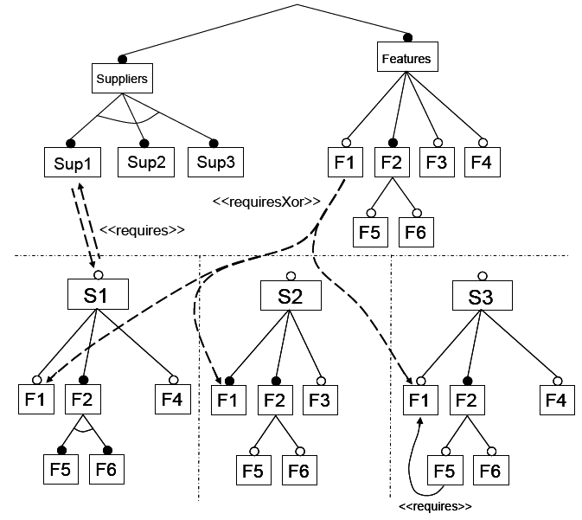
The Proposed Approach
END: We get a Composite Supplier Feature Model (CSFM)
(Only some of the dependencies are shown.)

Slide 22
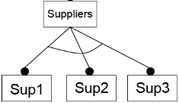








Back to the Problem again
Problem: Select an FM from the inputs.
Scenario 1: Primarily select the features.
Browse the SIFM;
Select F3;
F3 ⇒ S2.F3 ∧
S2.F3 ⇒ S2 ∧
S2 ⇒ Sup2;
Supplier2 has been selected.
Sup2 ⇒ (¬Sup1 ∧ ¬Sup3) ∧
¬Sup1 ⇒ ¬S1 ∧
¬S1 ⇒ ¬S1.F4 ∧
¬Sup3 ⇒ ¬S3 ∧
¬S3 ⇒ ¬S3.F4 ∧
(¬S1.F4 ∧ ¬S3.F4) ⇒ ¬F4
F4 has been deselected.
$$×$$
$$×$$
$$×$$
$$×$$
$$×$$
$$×$$
$$×$$

Slide 23

Scenario 2: Primarily select the supplier.
Select Supplier 1 ⇒ F3 is deselected.
$$×$$

Slide 24
Advantages and Drawbacks
Advantages
Easy to implement
The artifacts (e.g. code) connected with input FMs can be kept unchanged. (Important in scenarios described in approach #2.)
Drawbacks: Generate bad domain feature model which is hard to understand
Lots of redundancy
The relations between features in the result cannot be clearly seen

Slide 25
Agenda
Preliminaries: Feature Models
Motivation: Why merge FMs?
Approaches
Simple Combination Approach
Rule-based Approach
Logical Formula Approach
Our Work

Slide 26
Rule-based Approaches
Basic idea
Step1: Get result tree by rules
Traverse the feature tree level-by-level, from the root.
Decide the category of each parent-child relation by rules (i.e. mandatory, optional, or-group, xor-group)
Step2: Get cross-tree constraints by rules as well

Slide 27

Get the Result Tree
Automated merging of FMs using graph transformation. 2008
Composing feature models. 2009
Intersection mode: [[Result]] $=$[[FM1]] ∩ [[FM2]]
merge (root1: Feature, root2: Feature)
// root1 must matches root2
newRoot ← root1.copy()
// Merge the common children of root1 and root2
newPCR ← compute parent-child relation from root1 and root2 by intersection-rules
for each common child c of root1 and root2
merged_c ← merge (c of root1, c of root2)
newRoot.addChild(merged_c, newPCR)
return newRoot
newRoot
newRoot
newPCR
newRoot
newPCR
common1
…
common2

Slide 28
Compute Parent-Child Relation for Common Children: Intersection Rules
Example
R
R
R
+
=
C
C
C
FM1
FM2
Result
[[FM1]] = { {R, C} }
[[FM2]] =
{ {R}, {R, C} }
[[Result]] = { {R, C} }
= [[FM1]] ∩ [[FM2]]
FM2 FM1 | And-Mandatory | And-Optional | Xor | Or
And-Man | And-Man | And-Man | And-Man | And-Man
And-Opt | And-Man | And-Opt | Xor | Or
Xor | And-Man | Xor | Xor | Xor
Or | And-Man | Or | Xor | Or

Slide 29

Get the Result Tree (Cont.)
Union mode: [[Result]] $⊇$ [[FM1]] ∪ [[FM2]]
merge (root1: Feature, root2: Feature)
// root1 must matches root2
newRoot ← root1.copy()
// Merge the common children of root1 and root2
newPCR ← compute parent-child relation from root1 and root2 by union-rules
for each common child c of root1 and root2
merged_c ← merge (c of root1, c of root2)
newRoot.addChild(merged_c, newPCR)
// Insert the unique children of root1 and root2 to newRoot
for each unique child uc1 of root1
newRoot.addChild(uc1, AND-OPTIONAL)
for each unique child uc2 of root2
newRoot.addChild(uc2, AND-OPTIONAL)
return newRoot
newRoot
common1
common2
newRoot
common1
unique1
common2

Slide 30
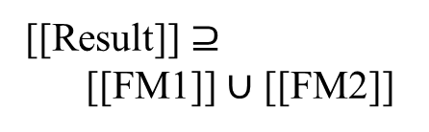
Compute Parent-Child Relation for Common Children: Union Rules
Example
R
R
R
+
=
A
B
A
B
A
B
FM1
FM2
Result
[[FM1]] =
{ {R, A}, {R, B}
{R, A, B} }
[[FM2]] ={ {R},
{R, A}, {R, B},
{R, A, B} }
[[Result]] $⊇$
[[FM1]] ∪ [[FM2]]
FM2 FM1 | And-Mandatory | And-Optional | Xor | Or
And-Man | And-Man | And-Opt | Or | Or
And-Opt | And-Opt | And-Opt | And-Opt | And-Opt
Xor | Or | And-Opt | Xor | Or
Or | Or | And-Opt | Or | Or

Slide 31

Insert Unique Children in the Union Mode
The rule
R
R
+
=
any parent-child relation
R
C
C $∉$ FM2
C
FM1
FM2
Result
[[FM1]] = { {R, C} }
or
[[FM1]] = { {R},
{R, C} }
[[FM2]] = { {R} }
[[Result]] = { {R},
{R, C} }
= [[FM1]] ∪ [[FM2]]

Slide 32
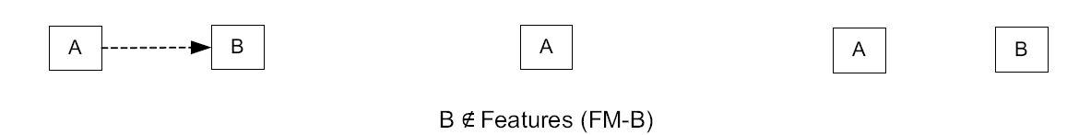
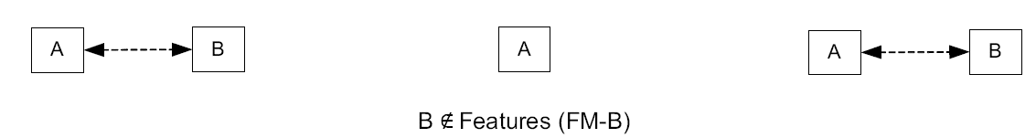
Get Cross-Tree Constraints
Similar to the refinements, use rules to match inputs and generate output.
Example rules of the union mode
FM1
FM2
Result
{A, B}, {B}
{A}
{A}, {B}, {A, B}
{A}, {B}
{A}
{A}, {B}

Slide 33
Advantages and Drawbacks
Advantages
Not hard to implement.
Generate feature model with acceptable quality.
Drawbacks
Some researchers argue that the semantics preservation of merge operation (especially in the intersection mode) is doubtful and needs strict proof.

Slide 34
Agenda
Preliminaries: Feature Models
Motivation: Why merge FMs?
Approaches
Simple Combination Approach
Rule-based Approach
Logical Formula Approach
Our Work

Slide 35
Logical Formula Approaches
Basic Idea
Transform input FMs into logical formulas
Compute result formula from the input formulas (“merge” input formulas)
Transform result formula into result FM

Slide 36
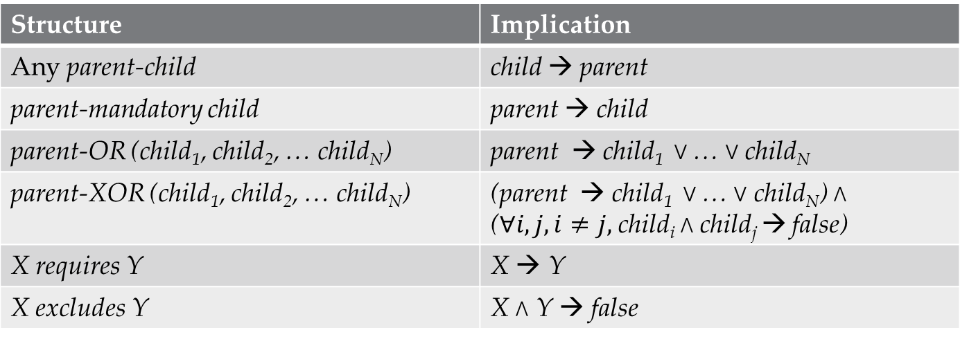
From FM to Logical Formula
Step 1: Map structures to implications
Structure | Implication
Any parent-child | child → parent
parent-mandatory child | parent → child
parent-OR (child₁, child₂, … child_{N}) | parent → child₁ ∨ … ∨ child_{N}
parent-XOR (child₁, child₂, … child_{N}) | (parent → child₁ ∨ … ∨ child_{N}) ∧ ($∀i,j, i≠j,$child_{i} ∧ child_{j} → false)
X requires Y | X → Y
X excludes Y | X ∧ Y → false
Step 2: The formula is a conjunction of all implications
SEMANTICS
Any assignment of Boolean values to all features that makes the formula satisfied represents a valid product of the feature model.
Notes:
Feature models, grammars, and propositional formulas

Slide 37

Merge Logical Formulas
Managing multiple SPLs using merging techniques. 2010
Strict union mode: [[Result]] = [[FM1]] ∪ [[FM2]]
Intersection mode: [[Result]] = [[FM1]] ∩ [[FM2]]
Formula
Feature Set
no ({F₁, F₂, … F_{N}}) = $¬$ F₁ ∧ $¬$ F₂ ∧ … ∧ $¬$ F_{N}
$$φResult=\left(φFM1 ∧no\left(ℱFM2∖ℱFM1\right)\right) ∨\left(φFM2 ∧no\left(ℱFM1∖ℱFM2\right)\right)$$
Features in FM2 but not in FM1
Products of FM1
Products of FM2
$$φResult=\left(φFM1 ∧no\left(ℱFM2∖ℱFM1\right)\right) ∧ \left(φFM2 ∧no\left(ℱFM1∖ℱFM2\right)\right)$$

Slide 38

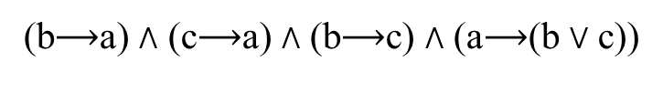
From Logical Formula to FM
Feature diagrams and logics: There and back again. 2007
Challenges
Many different feature models can be extracted from one formula.
The hierarchical structure of feature model is more than a logical structure.
a
c
a
(b$⟶$a) ∧ (c$⟶$a) ∧ (b$⟶$c) ∧ (a$⟶$(b ∨ c))
a
b
c
b
c
b
Car
Engine
Car$⟷$ Engine
vs.
Engine
Car

Slide 39
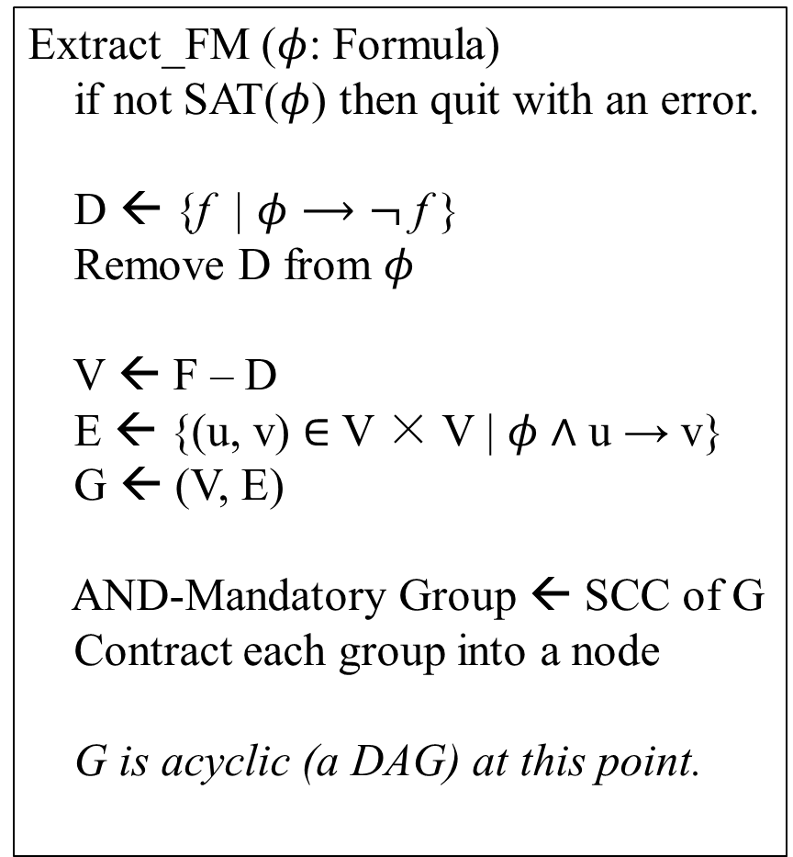
Proposed Algorithm (Outline)
Extract_FM ($φ$: Formula)
if not SAT($φ$) then quit with an error.
D ← {f | $φ⟶¬$ f }
Remove D from $φ$
V ← F – D
E ← {(u, v) ∈ V × V | $φ$ ∧ u → v}
G ← (V, E)
AND-Mandatory Group ← SCC of G
Contract each group into a node
G is acyclic (a DAG) at this point.
Check satisfaction
Remove dead features
Compute the implication graph
Extract AND-Mandatory groups
Extract OR, XOR groups (discuss later)
Extract AND-Optional (discuss later)

Slide 40
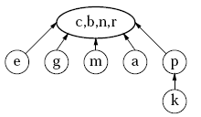


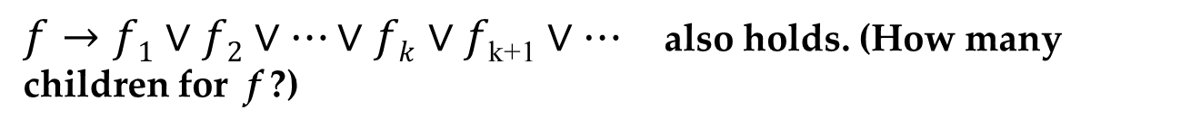

Extract from the Implication Graph
AND-Mandatory group
Contract the group into a node after extraction.
OR group
Problem: if the above implication holds, then
We need to extract the minimal children set for f.
XOR group
is an OR group, and
$$∀u, v∈V, u↔v$$
$$f→f1∨f2∨…∨fk$$
$f→f1∨f2∨…∨fk∨f\text{k}\text{+1}∨…$ also holds. (How many children for f ?)
$$∀1≤i,j≤k, i≠j, fi∧fj⟶false$$

Slide 41
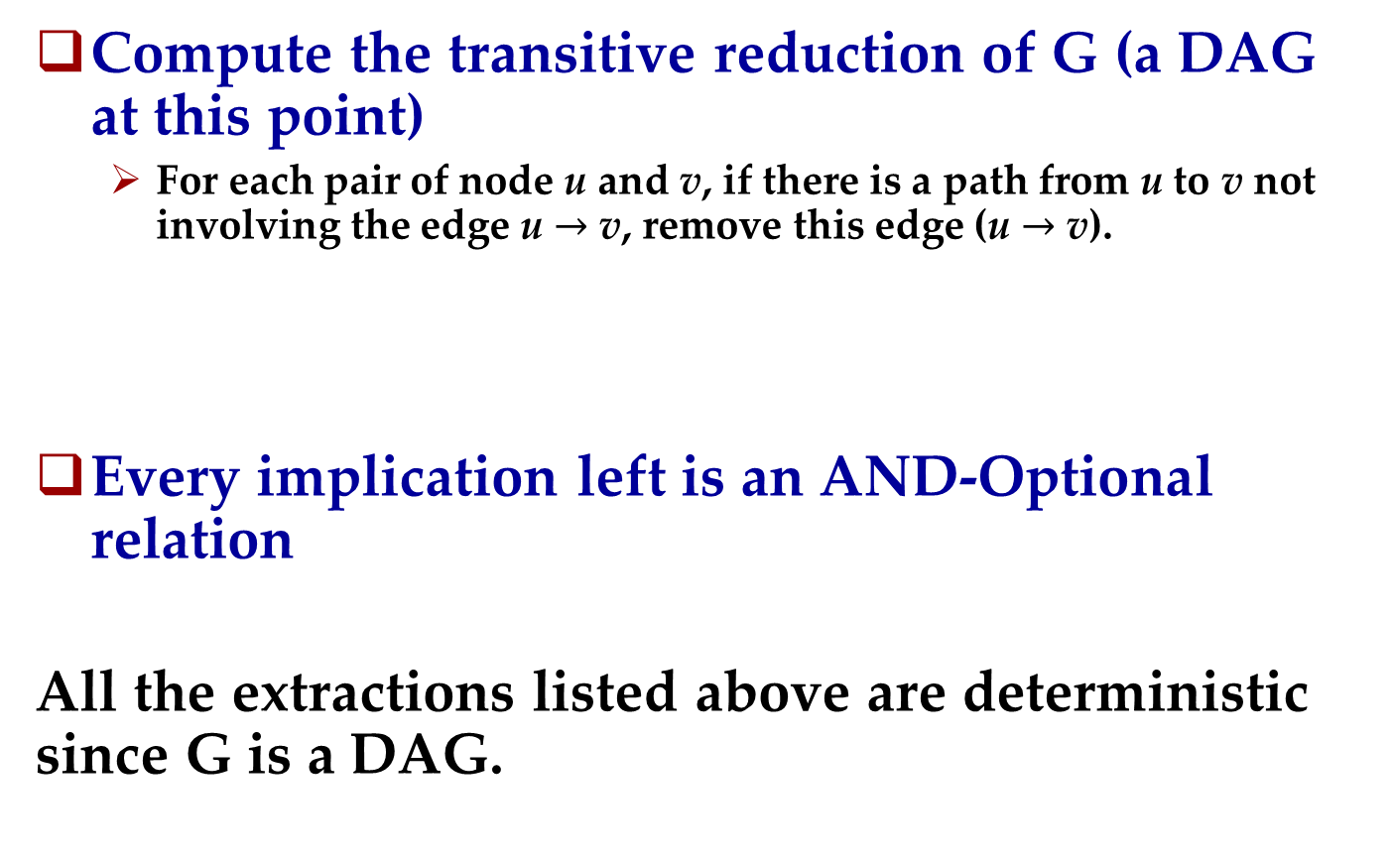
Extract AND-Optional
Compute the transitive reduction of G (a DAG at this point)
For each pair of node u and v, if there is a path from u to v not involving the edge u $→$ v, remove this edge (u $→$ v).
Every implication left is an AND-Optional relation
All the extractions listed above are deterministic since G is a DAG.
b
a
c
a
b
c

Slide 42
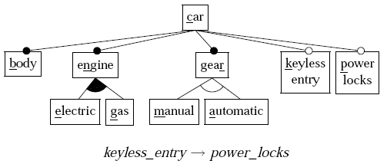
An Example
Original FM
Transform it there and back…
car, body, engine, gear
electric
gas
manual
automatic
power locks
keyless entry

Slide 43
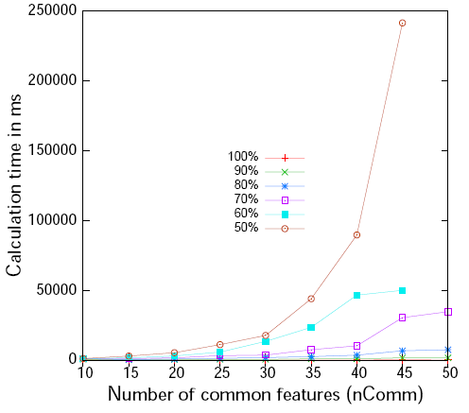
Advantages and Drawbacks
Advantages
Precisely preserve the semantics of merge operation.
Drawbacks
The result needs (lots of) refactoring to be easily understood by human. (One of the main benefits brought by FMs is that the FMs can be easily understood by customers.)
Performance: exponential to the size of FM.
Hard to implement.
Time (ms.)
Managing multiple SPLs using merging techniques. 2010

Slide 44
Agenda
Preliminaries: Feature Models
Motivation: Why merge FMs?
Approaches
Simple Combination Approach
Rule-based Approach
Logical Formula Approach
Our Work

Slide 45
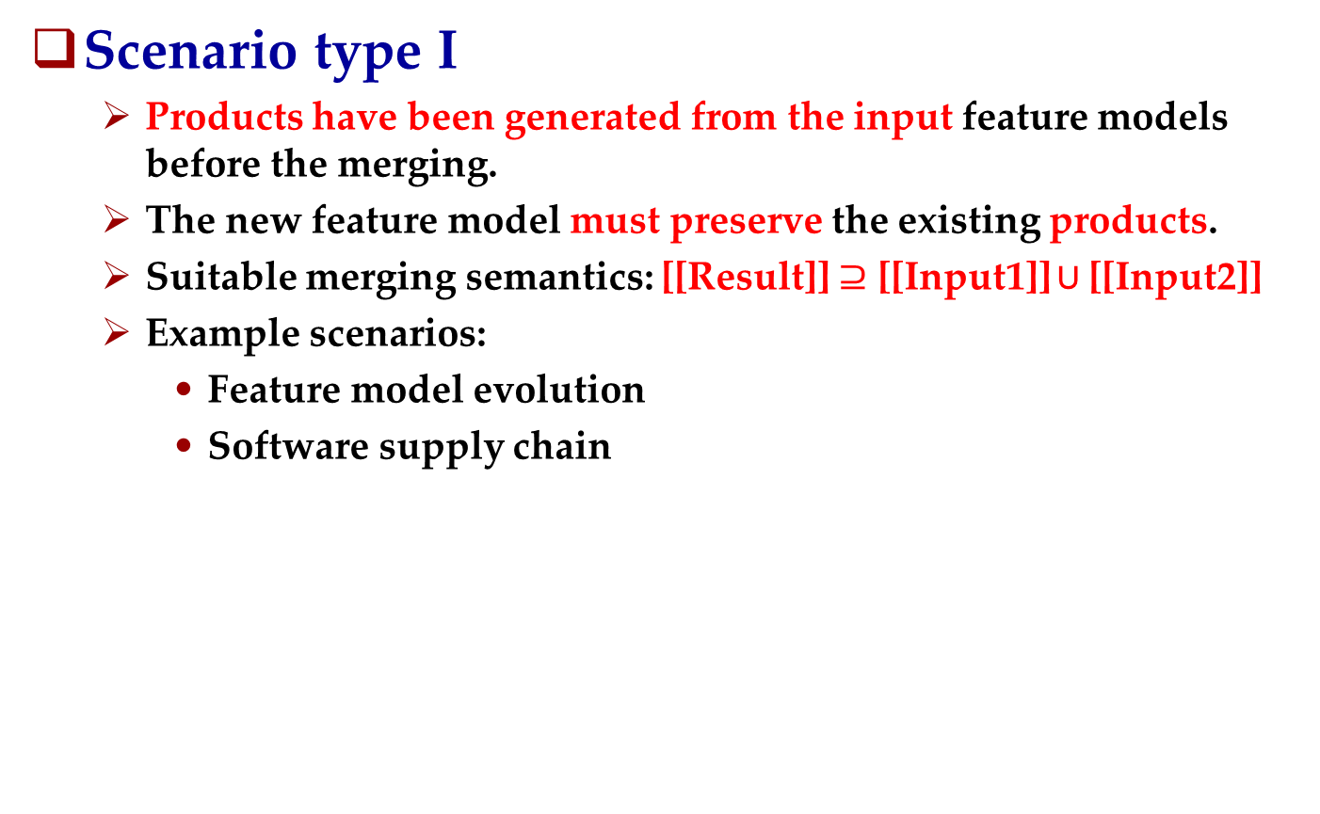
Revisit the motivation scenarios
Scenario type I
Products have been generated from the input feature models before the merging.
The new feature model must preserve the existing products.
Suitable merging semantics: [[Result]] $⊇$ [[Input1]] ∪ [[Input2]]
Example scenarios:
Feature model evolution
Software supply chain
Supplier 1
Supplier 2
Supplier 3
Upstream
Downstream

Slide 46
Our work focus on …
Scenario type II
When two feature models (of the same domain) are constructed independently, they may address different constraints and features of the domain.
We want to get a new feature model which preserve the constraints and features of the inputs.
Suitable merging semantics: ??
Existing algorithms focus on either Union or Intersection merging, which is not suitable for this scenario.

Slide 47
Motivation Example
FM
Products
Screen
Input 1
{Screen, LR},
{Screen, HR}
XOR
Low Resolution
High Resolution
Screen
Input 2
{Screen, Touch},
{Screen, Non-Touch}
XOR
Non-Touch
Touch
Expected
?
{Screen, Touch, HR},
{Screen, Touch, LR},
{Screen, Non-Touch, HR},
{Screen, Non-Touch, LR}

Slide 48
Motivation Example (cont.)
Existing Union algorithm, answer A:
{Screen, Touch},
{Screen, Non-Touch},
{Screen, LR},
{Screen, HR}
Screen
XOR
Touch
Non-Touch
LR
HR
Existing Union algorithm, answer B:
{Screen, Touch, Non-Touch, HR},
{Screen, Touch, HR, LR},
…
Screen
Touch
Non-Touch
LR
HR
Existing Intersection algorithm: (cut-off the unique features)
Screen
{Screen}
None of these answers is desirable.

Slide 49
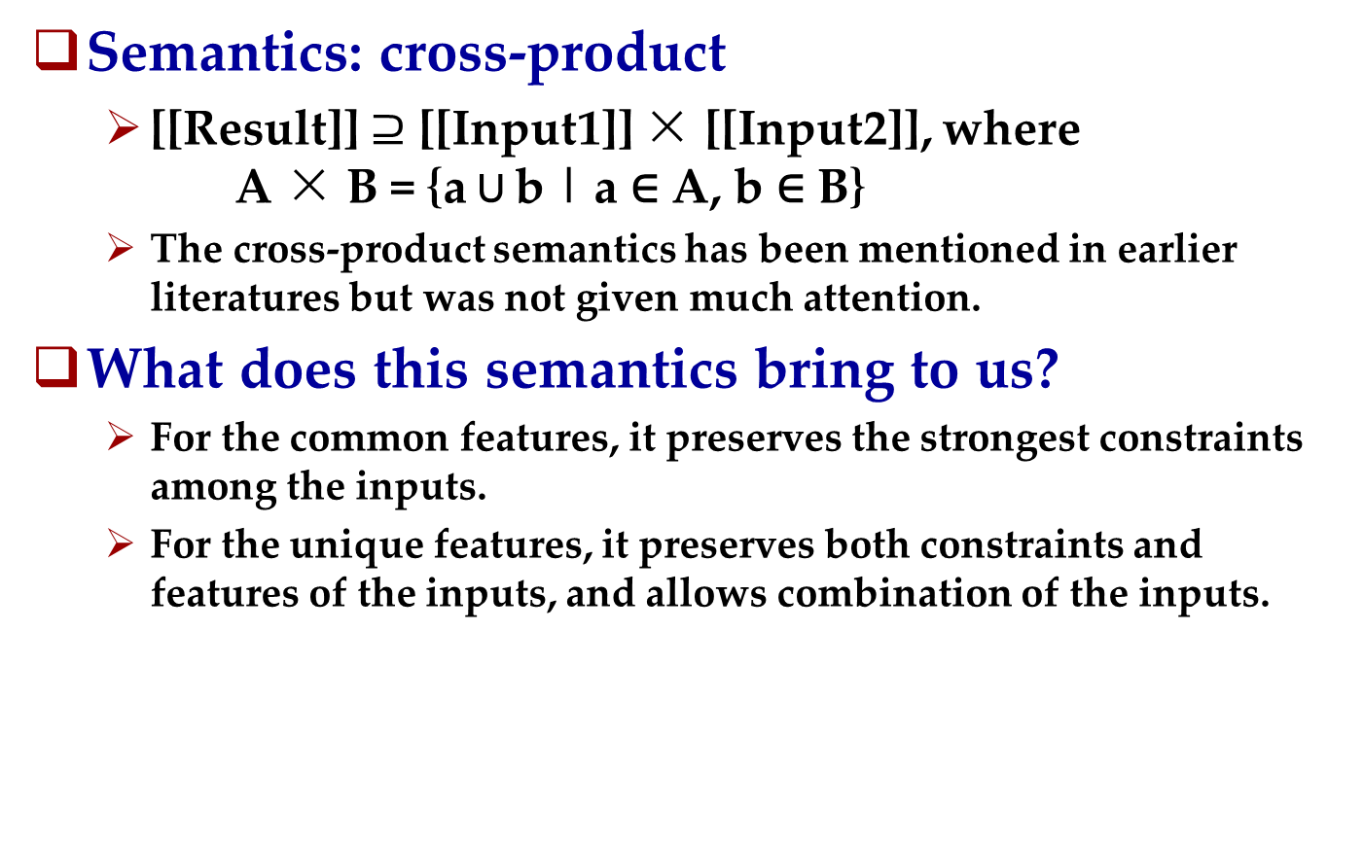
Semantics of our merging
Semantics: cross-product
[[Result]] $⊇$ [[Input1]] × [[Input2]], where A × B = {a ∪ b | a ∈ A, b ∈ B}
The cross-product semantics has been mentioned in earlier literatures but was not given much attention.
What does this semantics bring to us?
For the common features, it preserves the strongest constraints among the inputs.
For the unique features, it preserves both constraints and features of the inputs, and allows combination of the inputs.
[[Input1]] × [[Input2]] = {{Screen, Touch, HR},
{Screen, Touch, LR},
{Screen, Non-Touch, HR},
{Screen, Non-Touch, LR}}

Slide 50
Generate FM with acceptable structure
Basis
In our previous work, we defined a kind of feature model in which the refinements contained more semantics than other feature modeling approaches.
We define 3 types of refinements
Car
Screen
House
XOR
Engine
Light
Basic
Touch
Area
Height
Whole-part refinement
(2 mandatory parts)
General-special refinement
(2 XOR specializations)
Entity-attribute refinement
(2 mandatory attributes)
Notes:
Existing approaches merge FMs syntactically, we synthesize FMs.
An example:
FM1: Screen (Low Resolution, High Resolution) XOR
FM2: Screen (Touchable, Non-touchable) XOR
Existing approaches merge as: Screen (LR, HR, T, NT) XOR
How to get a product which has HR and Touchable screen?
In fact, some researchers have noticed such problem by introducing compositional multiple SPLs, i.e. add more constraints to enable such configuration. However, these constraints add more complexity.
Based on our previous work on FMs, we have defined three semantics of refinements, which is a basis of FM synthesis.
Use: merge local modification of models in CoFM.

Slide 51
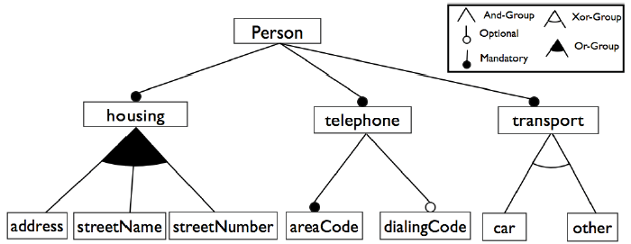
Compare with others
Composing feature models. 2009
Person
Our method
housing
telephone
transport
OR
XOR
address
street name
street number
area code
dialing code
car
other

Slide 52
Merge the unique features by semantics
In our method, we synthesis the refinements based on the additional semantics brought by our feature models.
Example: Synthesis orthogonal specializations
Screen
Screen
Screen
+
=
XOR
XOR
Resolution
Touch-ability
LR
HR
Touch
Non-touch
XOR
XOR
LR
HR
Touch
Non-touch
Rule: Specialization + Specialization = 2 (Attribute and Specialization)

Slide 53
FM Synthesis: At a Glance
A kind of union mode merging
Rule-based
Interactive
Use scenarios in our collaborative feature modeling environment
Synthesize multiple sub-trees which refine identical features.
Merge offline modifications into the repository.
…
EXPORT
Local
Repository
BBS
Forum
Modify
(The collaboratively constructed FM)
IMPORT
Local’
……
……
Notes:
Rule-based: for refinements and constraints
Can handle hierarchy mismatch
Union-mode

Slide 54
THANK YOU ! Q&A

